Slide 1
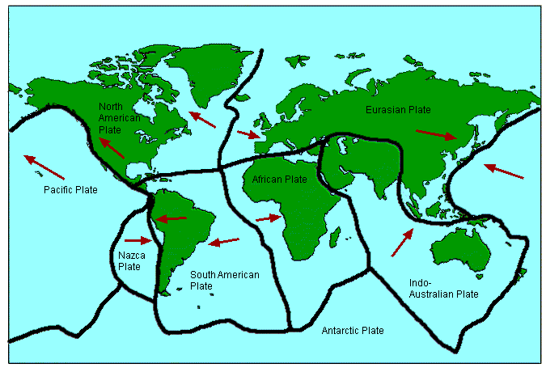
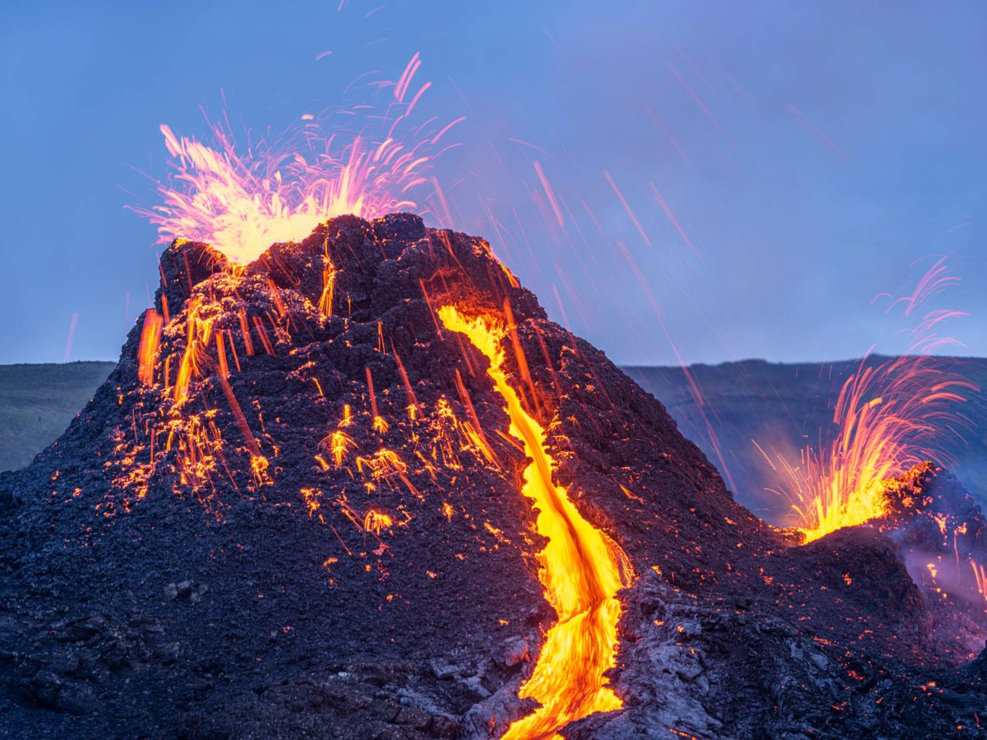
Which are more dangerous: earthquakes or volcanoes? Year 4 Knowledge Mat
Subject Specific Vocabulary
dormant volcano | A volcano that has not erupted in a long time.
epicentre | The point on the Earth’s surface immediately above the focus.
extinct volcano | A volcano that has not erupted in recorded history.
focus | The point at which an earthquake begins deep underground.
magma | Magma is molten rock from the mantle. Magma is within the surface of the Earth. Magma becomes lava only once it flows out over the surface land, for example with a volcanic eruption.
magnitude | The strength of an earthquake.
molten rock | Rocks that are in a liquid form.
plate boundary | Where tectonic plates meet.
Richter scale | The measurement of the magnitude of an earthquake.
seismologists | People who study earthquakes.
Sticky Knowledge
The Earth’s surface – the crust- is not one smooth unbroken covering. Rather it is made of different sections called plates.
There are eight major plates.
A type of mountain, formed at plate boundaries, is a volcano.
In its simplest terms, a volcano is formed when magma penetrates the Earth’s crust. This magma then cools and hardens to form solid rock, creating a mountain.
People make use of volcanoes, both active and dormant, and the volcanic environment.

